Slide 1
Ionic and Electron
Cross-Platform development

Slide 2

Cross Platform Development
AKA Hybrid Development
Learn more about the differences between native and hybrid development

Slide 3
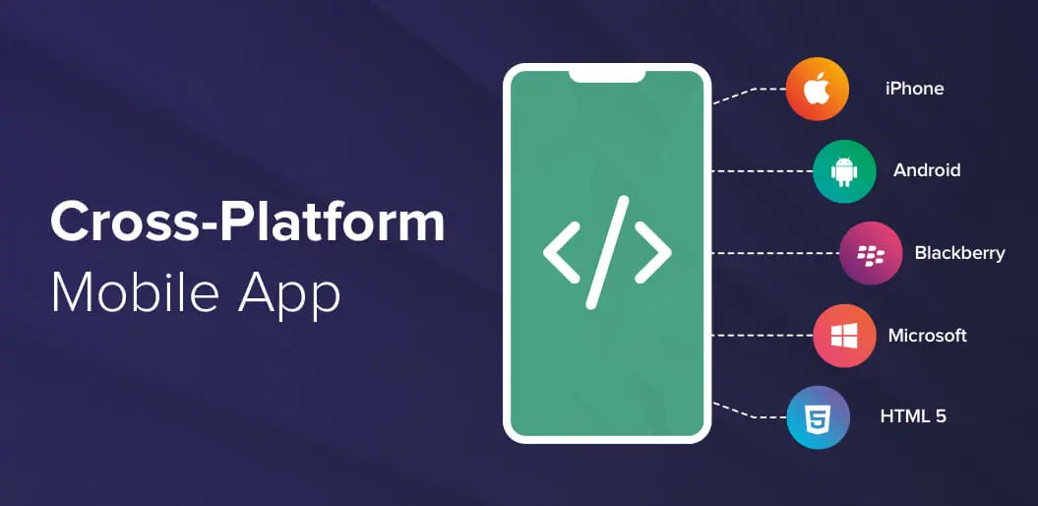
What is cross platform development
Cross-platform development is the creation of software applications that are compatible with on multiple operating systems either being desktop or mobile.
This is a better alternative to developing different versions on each platform.
The number of smartphone users worldwide is predicted to hit 3.5 billion by the end of 2020. 87% of smartphone users spend their mobile time on apps. The mobile app market will generate up to $581.9 billion in revenue by the end of 2020.
Source: Statista.com

Slide 4
Less code + More Useability
Write once, run anywhere
Use the talent you already in a development team
No need to hire new developers to port your code on Windows, mac, android and then IOS.
Save Time
Instead of spending time on learning how to design software on each operating system, learn how to do it once and let the cross development environment deal with the rest.

Slide 5
Drawbacks
system overhead
As everything is rendered in a webview (like) component they tend to use more hardware processing
Third-party dependence
In hybrid apps most of the time will use 3rd party software to access native elements or implement features across platforms
This makes more complex code and development
3rd party dependencies are constantly changing and being replaced so you need to keep up to date.

Slide 6

Electron

Slide 7
Overview
Electron is a framework for building desktop applications using JavaScript, HTML, and CSS. By embedding Chromium and Node.js into its binary, Electron allows you to maintain one JavaScript codebase and create cross-platform apps that work on Windows, macOS, and Linux.

Slide 8
Pros
Cons
Allows user to develop Desktop Applications using HTML, JS, and CSS
Electron uses Chromium engine for rendering UI. This means that you can get several benefits from this like Developer Tools, Storage Access, etc
Allows users to easily compile code for operating systems
The Chromium engine is the quite a heavy engine which can cause large files sizes for even simple applications.
It can be quite heavy on the system while running due to how chromium is designed.

Slide 9
Hello World
Lets create a simple Electron application where I will show you how you can have it packaged and compiled to be run as an executable.
Electron - Tutorial

Slide 10

Ionic

Slide 11
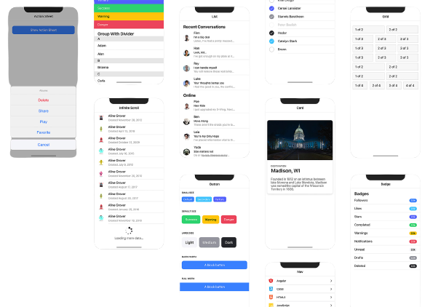
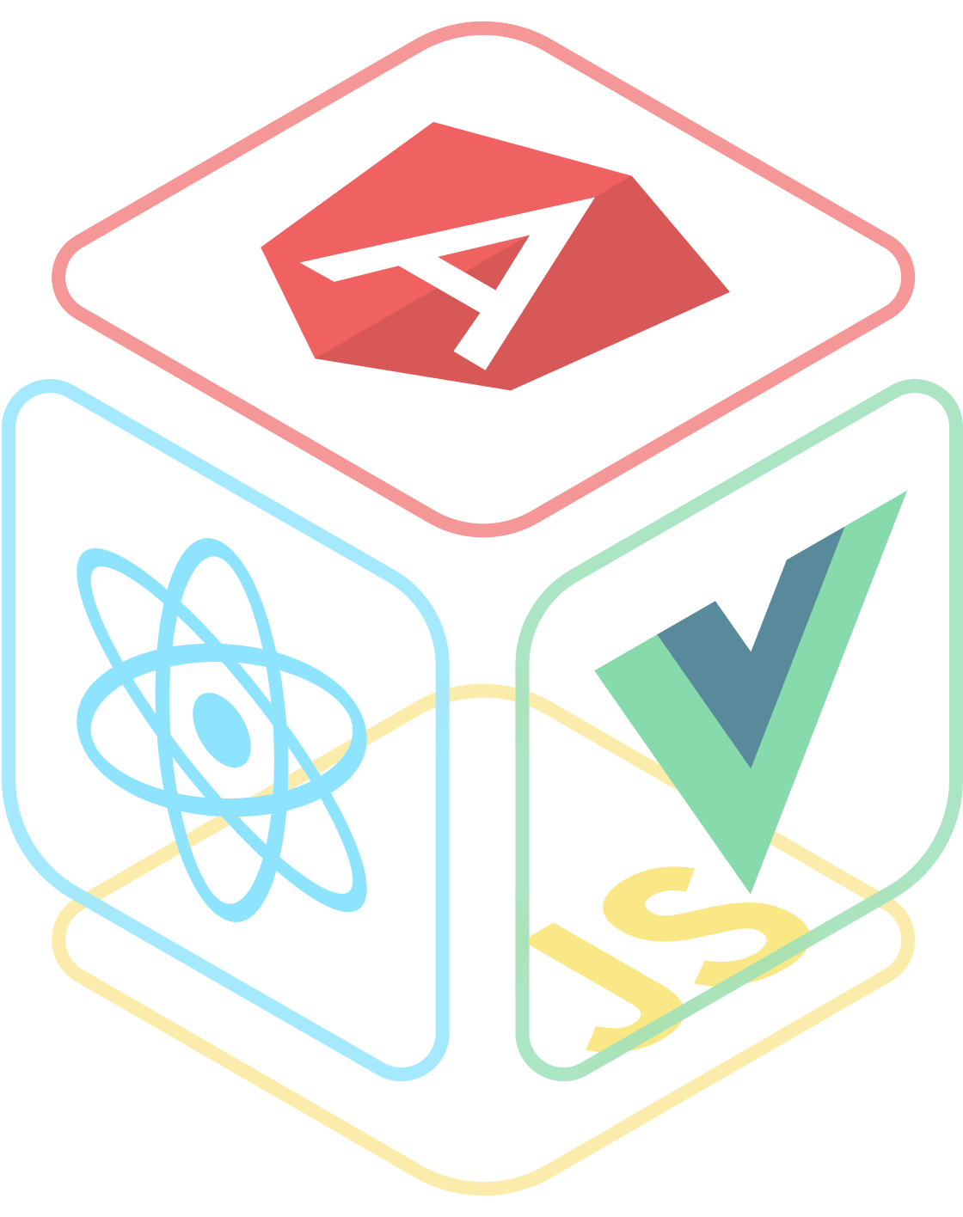
Overview
Like the Electron but…
Custom pre-built UI elements
Curated library of plugins
Multiple front-end development framework compatibility

Slide 12
Pros
Cons
A cloud host to deploy and manage Ionic apps
Account tiers to support your business
Build native code from Ionic codebase
Increased code complexity; clutter
Resource intense; large projects can have long build times
No integrated way to build to desktop sources; only web and mobile

Slide 13
Hello World
Introduction
Setup/Installation
Explore project
Preview project
Add views
Implement logic
Build: Preview In Android (if there’s time)
Ionic - Tutorial

Slide 14
Credits
Thanks you for sticking with the presentation till the end
And to SlidesGo for this google slides theme

